Slide 1
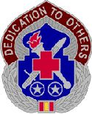
FOOD SAFETY COURSE
For Food Fundraisers on Fort Benning, GA
Environmental Health Section
Department of Public Health
Fort Benning MEDDAC

Slide 2
Course Design
Takes place of face-to-face class
Provides certification required for post fundraisers
Who?
  Anyone who prepares food for consumption
50 minutes instruction
Knowledge checks
Post exam
  Must pass with 80% or required to take again

Slide 3
Objectives
You will learn:
  How food becomes dangerous
  Proper food handling and preparation
  Proper food storage and temperatures
  Proper sanitation of materials
  Proper food transport

Slide 4
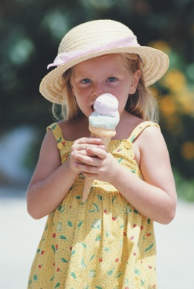
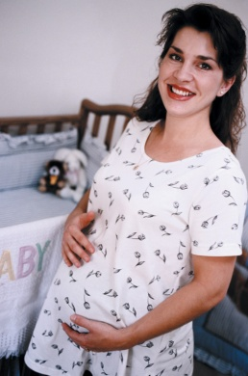
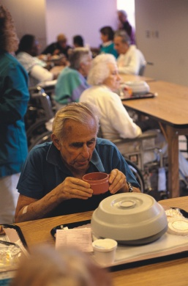
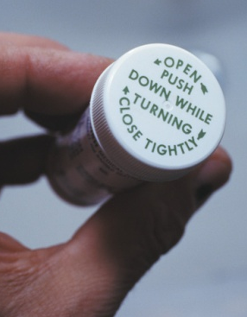
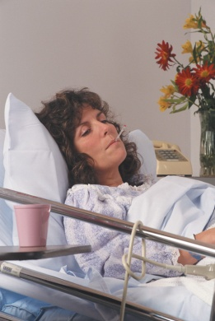
Who’s At Risk?
EVERYONE!
Higher Risk People
  Infants and preschool-age children
  Pregnant women
  Elderly people
  People taking certain medications
  People who are seriously ill
Notes:
Who is at risk for a communicable disease from food? Everyone! But those populations at a higher risk for more serious illness are infants and young children, pregnant women, the elderly, those taking certain medications, and those who are seriously ill or have a compromised immune system. How does this affect you and who you serve? Well, you can’t necessarily tell who is more at risk, so the best way to protect your customers is to take every precaution to reduce the chances of transmitting a food-borne illness.

Slide 5
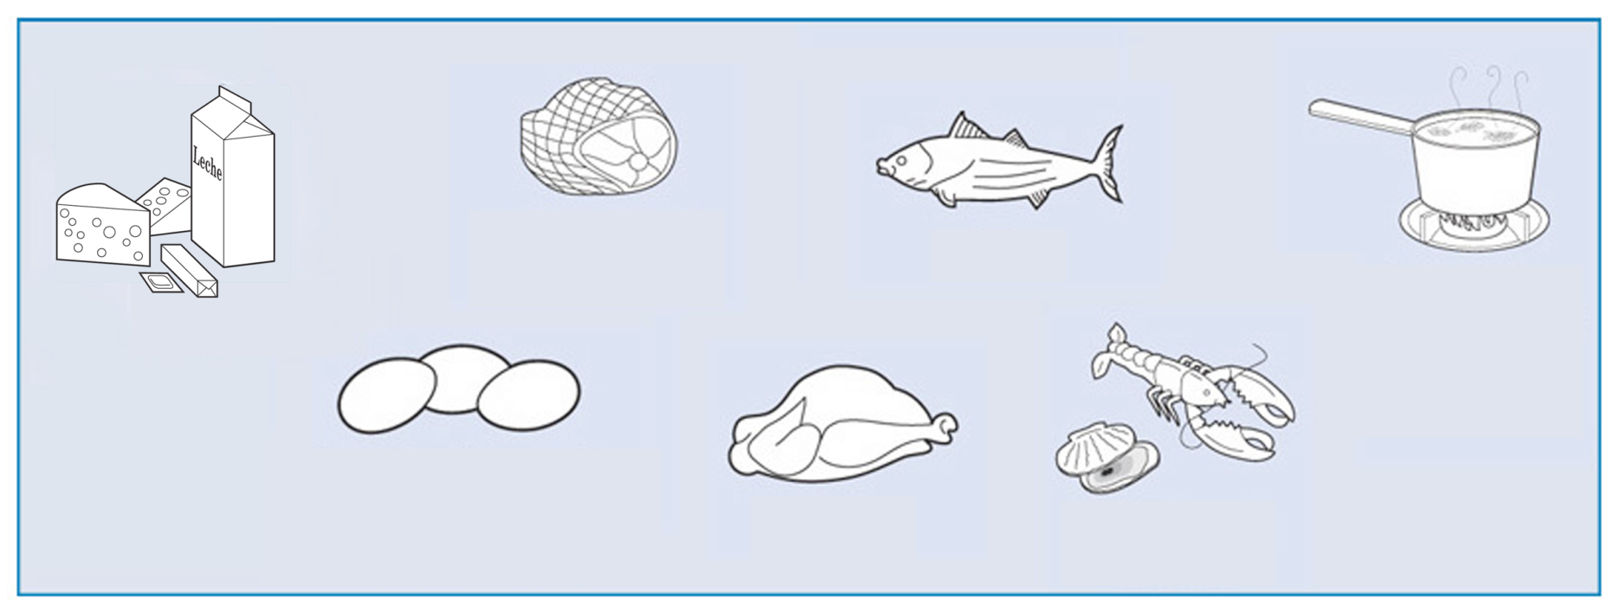
Potentially Hazardous Foods
All foods can transmit disease
Foods favoring rapid organism growth:
Meat: Beef, Pork,
Lamb
Fish
Fish
Heat-Treated Plant Food, such as Cooked Rice, Beans, and Vegetables
Milk and Milk
Products
Eggs (except those
treated to eliminate
Salmonella spp.)
Poultry
Shellfish and
Crustaceans
Notes:
All foods can transmit food-borne illnesses if contaminated, however there are some we call potentially hazardous foods that favor more rapid organism growth. These are: milk and milk products, meats, eggs, fish, poultry, shellfish, and heat-treated plant foods.

Slide 6
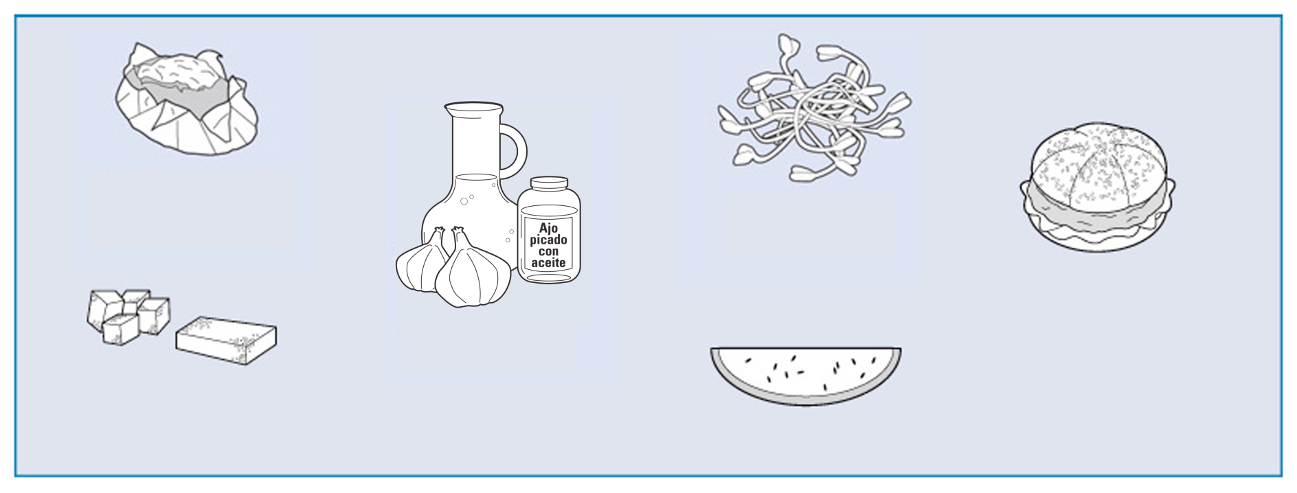
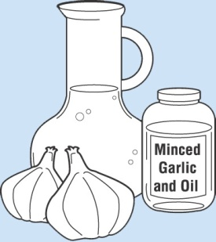
Potentially Hazardous Food
Food Favoring the Rapid Growth of Microorganisms: continued
Baked
Potatoes
Raw Sprouts and
Sprout Seeds
Synthetic Ingredients,
Such as Textured Soy
Protein in
Meat Alternatives
Untreated Garlic-and-Oil
Mixtures
Tofu or Other
Soy-Protein Food
Sliced Vegetables and Melons
Notes:
Instructor Notes
More hazardous foods are baked potatoes, tofu, untreated garlic and oil mixtures, raw sprouts and seeds, sliced vegetables and fruits, and other synthetic ingredients. But it’s important to remember that all foods can transmit bacterial and viral diseases.

Slide 7
Knowledge Check
Only potentially hazardous foods can transmit food-borne illnesses.
True or False?
Notes:
Answer: False. Remember, ALL foods can transmit food-borne illnesses.

Slide 8


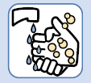
How Food Becomes Unsafe
Time-Temperature Abuse
Cross-Contamination
Poor Personal Hygiene
Notes:
Now we will learn how food can become unsafe. The most common ways food becomes unsafe is through time and temperature abuse, cross contamination, and poor personal hygiene. We will discuss all of these and how to prevent these problems.

Slide 9
Time-Temperature Abuse
Food has been abused:
  Any time it has been allowed to remain too long at temperatures favorable to the growth of food-borne microorganisms
  Examples:
    Food in your cart at the grocery store
    Driving home
    Cooking (until food reached 140 degrees)
Temperature Danger Zone: 40-140 degrees F
Notes:
To keep food safe, we can control 2 things: time and temperature. We limit the time food spends in the temperature danger zone to 4 hours because generally that is the amount of time bacteria need to reproduce to unsafe levels and make us sick. The temperature danger zone is 40-140 degrees Fahrenheit. Therefore all foods that are temperature dependent should not be within 40-140 degrees Fahrenheit for longer than 4 hours. This is cumulative so anytime it is in this temperature range, the clock is ticking. For example, if you are preparing chili, you must count the time that the meat was out of the refrigerator from the time you bought it at the store until you get home and put it away, the time it is out of the refrigerator until it is cooked to proper temperatures, and the time that it takes for it to be packaged in containers and cooled to below 40 degrees for storage.

Slide 10
Preventing Time-Temperature Abuse
  Minimize the time food spends in the temperature danger zone
  Determine the best way to monitor time and temperature
  Have accurate thermometers available and record when temperatures are taken
Notes:
The best way to prevent time temperature abuse is by putting groceries in the refrigerator or cooler as soon as possible. Other ways include checking temperatures often to ensure food is out of the temperature danger zone. You should have a stem thermometer to measure temperatures of food. If you do not have a thermometer available, you should monitor how much time it is out of the refrigerator, freezer, or oven.

Slide 11
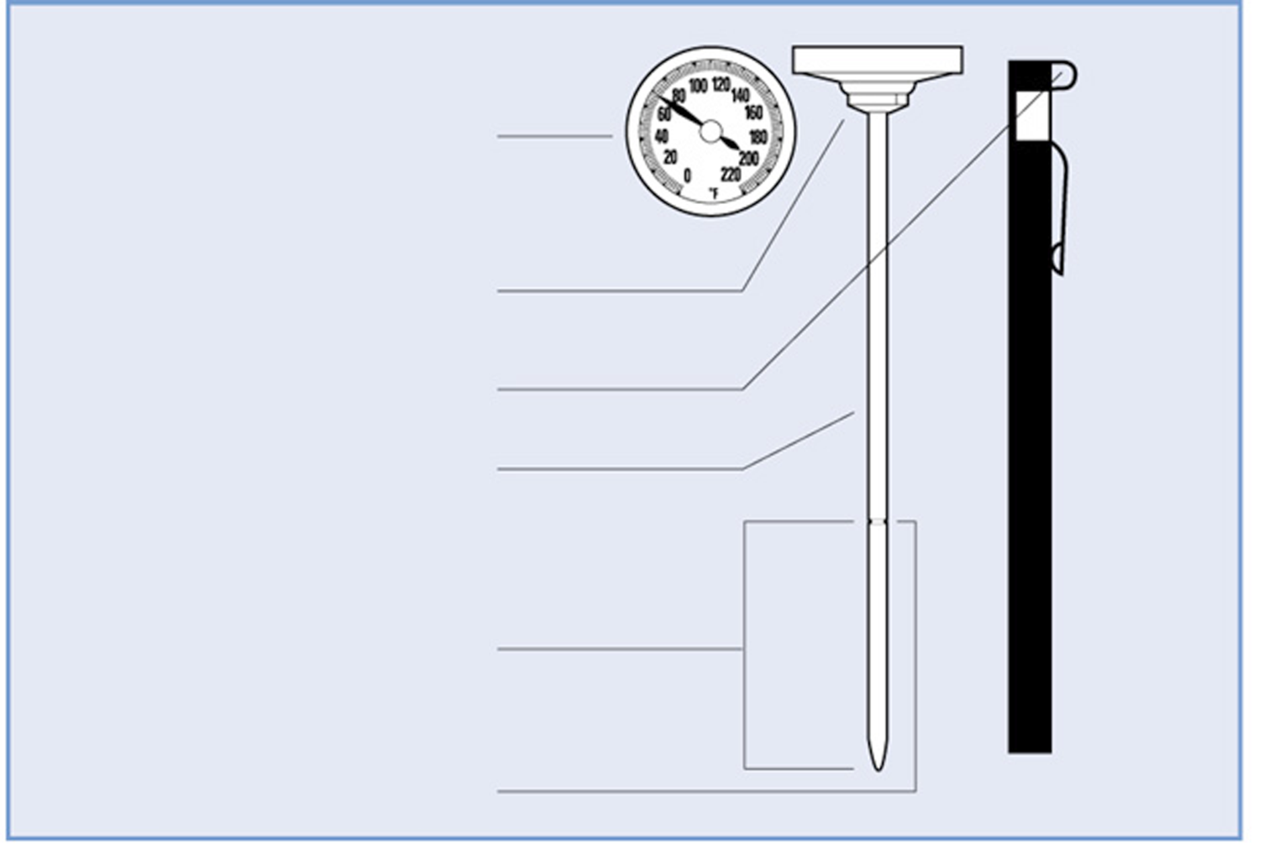
Temperature-Measuring Devices
Bimetallic Stemmed Thermometer
Indicator Head
Calibration Nut
Holding Clip
Stem
Sensing Area
Dimple
Notes:
Instructor Notes
Bimetallic stemmed thermometers are the most common thermometers for taking food temperatures. They are inexpensive and easy to maintain. One thing to know is that the temperature sensor is not at the bottom of these thermometers. You have to look for a small dimple on either side which tends to be near the middle of the stem. This is where the temperature is taken. This dimple should be inside the food for accurate readings. Take the temperature at the thickest part of the food, or in the middle if it is a casserole or soup. If your stem thermometer is not digital, the thermometer should be calibrated before use, so we recommend that you purchase the digital thermometers.

Slide 12
Knowledge Check
What is the temperature danger zone?
  50-150 degrees Fahrenheit
  40-140 degrees Celsius
  40-140 degrees Fahrenheit
  30-130 degrees Fahrenheit
Notes:
Answer: 40-140 degrees Fahrenheit

Slide 13
Knowledge Check
How long can food be held in the temperature danger zone before it should be eaten or thrown away?
  3 hours
  4 hours at a time
  4 hours cumulatively
  4.5 hours
Notes:
Answer: 4 hours cumulatively

Slide 14
Cross-Contamination
Cross-contamination occurs when:
  Microorganisms are transferred from
  one food or surface to another
  Examples
    Cutting meat on the same board as vegetables
    Covering your mouth when you sneeze, but not washing your hands before working with food
Notes:
Another way food becomes unsafe is through cross contamination. Cross contamination occurs when some type of contamination (like bacteria) is on one food and it crosses over to another food. This can happen in several ways. The most common is cutting boards. You cut one product, for example raw chicken, which leaves the bacteria on the surface for the next product to pick up if the cutting board is not cleaned in between. So the contamination crosses to other foods.

Slide 15
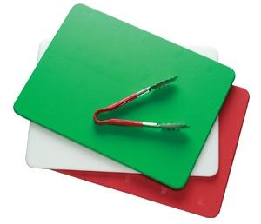
Preventing Cross-Contamination
Create physical barriers between food products:
  Assign specific equipment to each type of food
    Easiest way is to use colors; i.e. green for vegetables
  Clean and sanitize work surfaces, equipment, and utensils after
  each task
Notes:
Ways to prevent cross-contamination include color coding or labeling cutting boards so that they are used for one type of food product, such as one board for meats and another for fruits and vegetables. Another method is to ensure all equipment is cleaned and sanitized after each task. You should never cut meat on a wooden cutting board, because a wooden surface cannot be sanitized. It is best to use plastic cutting boards when preparing food for fundraisers, as well as separate utensils for different items of food. Don’t assume that you will kill off all bacteria from the cooking process, especially if you are unable to monitor temperatures with a thermometer.

Slide 16
Knowledge Check
You are preparing strawberry shortcake and chicken salad. You need to cut up strawberries and cooked chicken on the same day. As long as you cut the strawberries first, you can cut the chicken on the same cutting board without washing it in between.
True or false?
Notes:
Answer: False. Fruits can transmit bacteria. Always wash and sanitize a cutting board between foods, or use separate cutting boards.

Slide 17
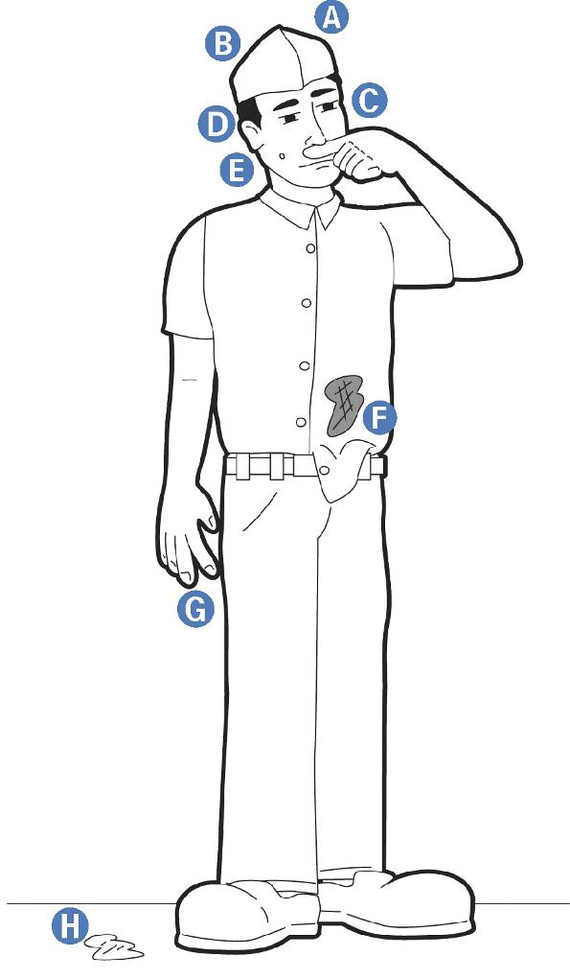
Poor Personal Hygiene
Behaviors that can contaminate Food
A
A
Scratching the scalp
Running fingers
through hair
Wiping or touching
the nose
Rubbing an ear
B
E
Touching a pimple or open sore
Wearing a dirty uniform
Coughing or sneezing into the hand
Spitting in the establishment
D
C
B
E
F
C
G
F
D
H
G
H
Notes:
Instructor Notes
The third most common way food becomes unsafe is with poor personal hygiene. Thirty to 50 percent of healthy adults carry Staphylococcus aureus in their nose, and about 20 to 35 percent carry it on their skin.
If these microorganisms contaminate food, the consequences can be severe. To prevent this, food handlers must avoid the behaviors indicated in the slide. Another example of human transmission is noro virus. This is an intestinal virus that can be transmitted from the hands if they are not washed properly after using the restroom. There are many examples of noro virus outbreaks on cruise ships when crew members or customers of the cruise do not properly wash their hands, eat at a buffet, and transfer the virus to buffet serving utensils, which in turns make hundreds of other vacationers sick. You do not have to have symptoms of a food borne illness to transmit the bacteria or virus, so good hygiene is essential whether you think you are sick or not.

Slide 18

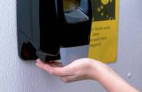


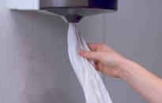
Proper Hand washing Procedure
The whole process should take 20 seconds
1
Wet hands with running water as hot as you can comfortably stand
2
Apply soap
3
Vigorously scrub hands and arms for ten to fifteen seconds
4
5
Rinse thoroughly under running water
5
Dry hands and arms with a single-use paper towel or warm-air hand dryer
Notes:
Instructor Notes
Hand washing is the most critical aspect of personal hygiene.
When washing hands, you should apply enough soap to build up a good lather. Lather well beyond the wrists, including the exposed portions of the arms. Vigorously scrub hands and arms for ten to fifteen seconds. Clean under fingernails and between fingers.
After drying hands, turn off the faucet using a single-use paper towel, if available. When in a restroom, use a paper towel to open the door. It is best to use paper towels and not a cloth towel.

Slide 19
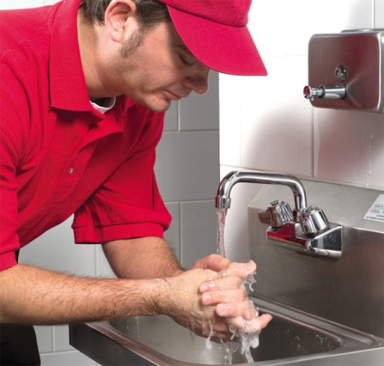
When to Wash your hands
Using the restroom
Handling raw food (before and after)
After touching the hair, face, body, or clothing
After handling money
  We suggest having one person just dealing with money and not food
After smoking, eating, drinking, chewing gum or tobacco
After handling chemicals that might affect the safety of food
Going to the restroom
Notes:
You should wash your hands whenever you feel that something has contaminated them which, in turn, can contaminate the food you are serving. However, you MUST wash your hands before and/or after handling raw food, touching any part of your body, smoking, eating, drinking, handling chemicals, and going to the bathroom. When serving food at your fundraiser, if items are not individually wrapped and you are serving food, it is best to have one person serving food while another person handles money.

Slide 20
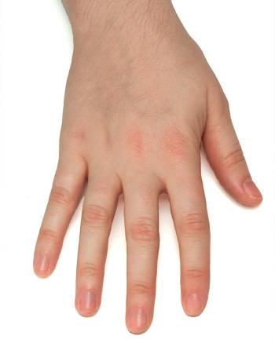
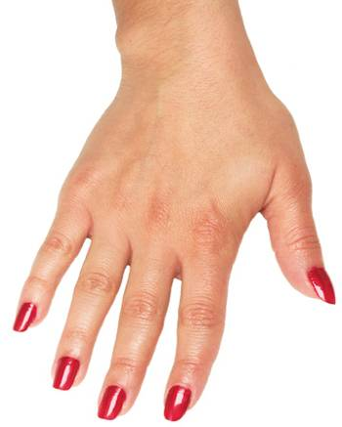
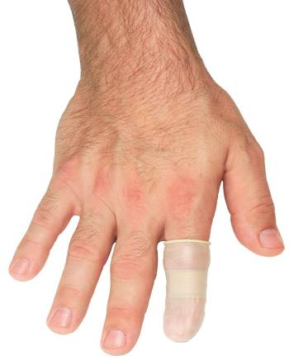
Hand Maintenance
Requirements for Food handlers
Keep fingernails
short and clean
Do not wear false
nails or nail polish
Bandage cuts and cover bandages
Notes:
Instructor Notes
Long, false, and acrylic nails should not be worn because they may be difficult to keep clean. They also may break and fall into food.
Nail polish can disguise dirt under nails and may flake off into food.
Cover all hand cuts and sores with clean bandages. If there is a bandage on the hand, then gloves should be worn at all times to protect the bandage and prevent it from falling off into food.

Slide 21
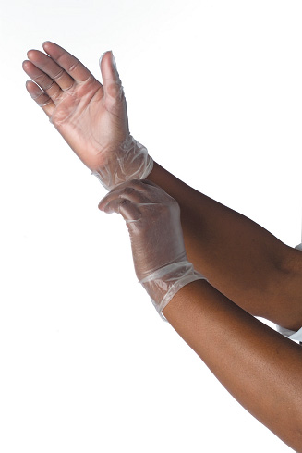
GLOVES
Must never replace hand washing
Are for single-use only
Must fit and be used properly
Change your gloves anytime where you would wash your hands
Gloves do NOT make you unable to contaminate food
Notes:
Gloves must be used anytime someone is handling food not individually wrapped at fundraisers, such as chili or hotdogs. Gloves do not replace hand washing, so you should still wash your hands and change gloves when contaminated. You can still contaminate food with gloves. The best thing when serving and handling food is to not handle foods directly with your hands, but use clean utensils.

Slide 22

Food handler Rules
Must have hair restrained
  Can be a hair net, hat, or visor
  Long hair must be effectively restrained, like a braid or bun
    This may need 2 or more restraints to be effective
Must remove all jewelry
  Can wear a medical ID and/or plain wedding band ONLY
Can not eat, drink, smoke, or chew near food operations
Hand Sanitizers
  Can be used after hand washing
  Must be FDA Approved
Notes:
Other rules to follow when preparing and serving food for your fundraiser: you must have hair restrained, even if you are a male. You can wear a hat while serving food. If you have long hair, you should have it restrained in a ponytail, braid, or bun. You should not wear earrings, necklaces, or bracelets. While preparing and serving food, please do not eat or drink. You should take a break to do these things, and wash your hands before coming back to preparing or serving food. Hand sanitizers can be used after hand washing. Make sure to rub your hands until the sanitizer has dried, do not dry your hands with a towel.

Slide 23

Preparing Food
Clean and sanitize food prep areas, utensils, and other items before using
Restrain hair, remove jewelry
Wash hands thoroughly
Plan your preparation:
  Get all individual ingredients ready, keeping cold foods like eggs, milk, etc in the refrigerator until ready to use
Make sure to preheat ovens thoroughly before cooking
Watch the clock!
Notes:
Let’s discuss the proper steps to protect food while you are preparing it. You should first clean and sanitize food preparation areas, utensils, and other items before using. Restrain your hair, and remove dangly jewelry. Wash your hands thoroughly. Plan your preparation, get all individual ingredients read, making sure to keep cold foods in the refrigerator up until you use them. Preheat ovens thoroughly before cooking, and watch the clock to make sure you do not exceed your four hours of uncontrolled temperature time.

Slide 24
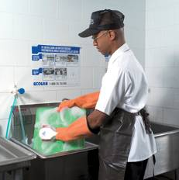
Cleaning Vs. Sanitizing
Cleaning
  Process of removing food and other types of soil from a surface
Sanitizing
  Process of reducing the number
  of microorganisms on a clean surface
  to safe levels
  Surfaces must first be cleaned rinsed before being sanitized
Notes:
To be effective, cleaning and sanitizing must be a two-step process. Surfaces must first be cleaned and rinsed before being sanitized. With cleaning, you remove the visible debris. Sanitizing is when you use some type of method to chemically remove microorganisms. Sanitizing is not effective if you do not clean first.

Slide 25
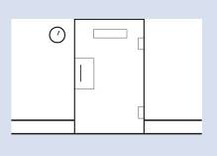
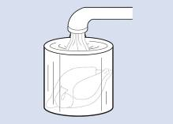
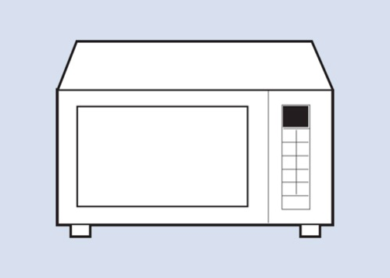
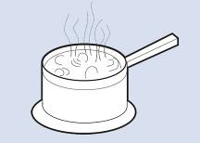
Thawing Food
The Four Acceptable Methods for Thawing Food
In a refrigerator, at
41°F (5°C) or lower
Submerged under running potable water, at a temperature of 70°F or lower
In a microwave oven, if the food will be cooked immediately after thawing
As part of the cooking
process
8-3
Notes:
Freezing does not kill microorganisms. To prevent bacterial growth, food should never be thawed at room temperature. The four acceptable methods for thawing food are in a refrigerator, submerged under running cold water, in the microwave if the food will be cooked immediately after, or as part of the cooking process. When thawing under running water, the water cannot be hot because that spot where the water hits ends up being in the temperature danger zone while thawing. Thawing takes time, so please plan food preparation for your fundraiser ahead of time to follow this important rule. The preferred method is to thaw in the refrigerator, since you know that the temperature has been controlled at all times. To verify that your refrigerator is operating below 41 degrees, place a thermometer for 2-3 minutes with the door closed.

Slide 26
Preparing Salads Containing PHF’s
Examples are tuna salad, macaroni salad, etc
When preparing salads containing potentially hazardous ingredients:
  Prepare product in small amounts
  Refrigerate ingredients until the point they are needed
  Chill all ingredients and utensils prior to using them
8-4
Notes:
PHF stands for potentially hazardous food. You should remember this from earlier in the slides. Chicken, tuna, egg, pasta, and potato salads all have been involved in foodborne-illness outbreaks. Since these salads are not typically cooked after preparation, there is no chance to eliminate microorganisms that may have been introduced during preparation.
Ingredients should be left in refrigeration until the point that they will be mixed together.
Consider chilling all ingredients and utensils before using them to make the salad. For example, tuna, mayonnaise, and mixing bowls can be chilled before making tuna salad.
Prepare the salads in small batches, so large amounts do not sit out at room temperature for long periods of time.

Slide 27
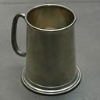


Toxic Metal Poisoning
Acidic foods can cause some metals to leak into the food when using certain cookware
Lead
  Usually found in pewter (Older pitchers)
Copper
  Cookware
Zinc
  Galvanized items (item is coated with zinc)
Notes:
Acidic foods can cause some metals to leach into food when using certain cookware, which can be dangerous to those eating the food. It is best not to use items containing lead, usually found in pewter, copper cookware, and galvanized items coated with zinc.

Slide 28
Knowledge Check
What is NOT a proper way to thaw foods?
  In the refrigerator
  In the microwave
  On the counter
  Under cold running water
  As part of the cooking process
Notes:
Answer: On the counter

Slide 29
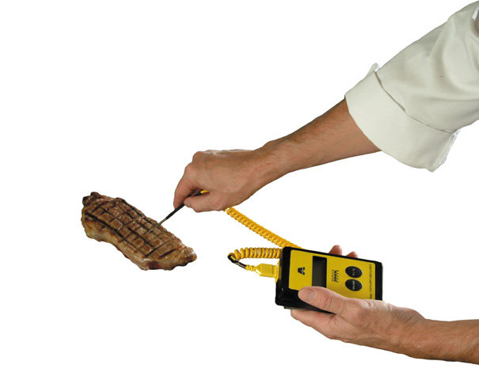
Cooking Food
When cooking potentially hazardous food, the internal
portion must:
  Reach the required minimum internal temperature
  Hold that temperature for a minimum of 15 seconds
Notes:
Instructor Notes
The only way to reduce some microorganisms in food to safe levels is to cook it to the required minimum internal temperature. This temperature varies from product to product. Minimum standards have been developed for most food.
The only way to be certain food has reached the required minimum internal cooking temperature is to check it using a thermometer. The temperature should be checked in the thickest part of the food, and at least two readings should be taken in different locations.
It is important to remember that potentially hazardous food—such as meat, eggs, and seafood—should be cooked to the minimum internal temperatures specified in these slides. If a customer is from a high-risk population, consuming raw or undercooked, potentially hazardous food could significantly increase their risk of foodborne illness. Raw or not fully cooked foods are prohibited at food fundraisers.

Slide 30
Cooking Temperatures
165⁰F | 155⁰F | 145⁰F
Poultry (cannot be stuffed) | Egg/Egg products | Fish
Stuffed Dishes | Hamburgers | Steaks/Chops
Microwave | Ground meat | Anything not specified

Slide 31
Knowledge Check
What internal temperature should chicken be cooked to for at least 15 seconds?
  165 degrees Fahrenheit
  155 degrees Fahrenheit
  145 degrees Fahrenheit
  150 degrees Fahrenheit
Notes:
Answer: 165 degrees Fahrenheit

Slide 32
Packaging Baked Items
Individually wrap pastry items (cakes, brownies, cookies, etc) and mark with the following:
  Date
  Time
  Initials of preparer
This is so questions can be directed to the person who cooked/ baked the food
Cream filled pastries are prohibited

Slide 33
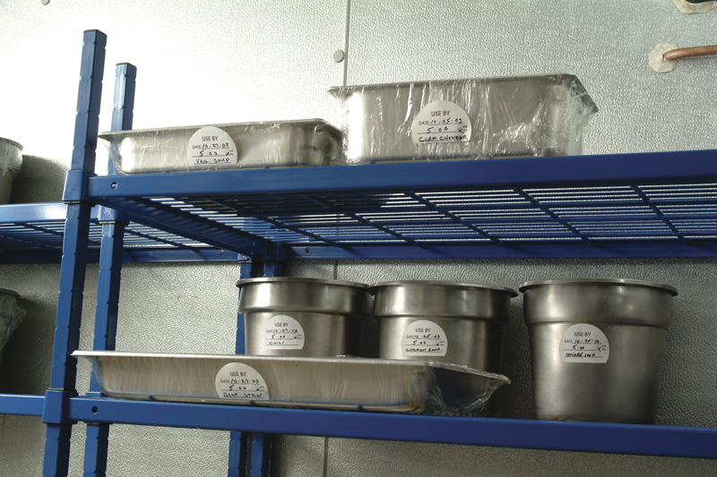
Labeling Foods
Label Food
Potentially hazardous, ready-to-eat food prepared on-site must contain a label that includes:
  The name of the food
  When it was altered (opened, prepared, etc.)
7-3
Notes:
Labeling food is one of the most important steps that is commonly missed at fundraisers. Labeling includes: The name of the food if it is not common (example: an apple does not have to be labeled), and when it was opened or prepared. We also suggest the preparer put their initials on the label for any questions regarding ingredients.

Slide 34
Packaging/Storing Food
Preparing food day(s) before:
  Cooked food should be chilled within 2 hours.
  Large amounts of hot food should be separated into smaller containers before placing in freezer/refrigerator.
  Large amounts of hot food will cause refrigerator/freezer to heat up: turn down temp on unit while cooling
Notes:
These steps are very important to follow because this is part of the four hour temperature danger zone. If you do not cool foods to below 40 degrees Fahrenheit fast enough, you may cause bacteria to multiply.

Slide 35
Reheating Food for Fundraiser
If you prepared food on a different day and need to reheat the day of:
  Have a crock pot on low heat waiting for food
  Foods need to be reheated as quickly as possible to correct temp
    For liquid foods, place in a pot on stove, medium to high heat, and stir often to heat food quickly
    For solid foods, reheat in preheated oven
    TAKE TEMPERATURES! Refer to temperature chart.
  Place liquid foods in a preheated crock pot for transport.

Slide 36
Packaging/Storing Food
Same day
  Hot foods:
    Have a plan to keep food hot, or be within short driving distance (less than 30 minutes)
    Have a crockpot already heated up to contain hot foods, crockpot should help foods remain hot during transport.
    Plug in crockpot AS SOON AS you get to the fundraiser
  Cold foods:
    Have coolers with plenty of ice to pack cold foods in.
    Have a dial thermometer in the cooler to monitor temperature

Slide 37
Transporting Food
Keep completely covered to prevent contamination
Temperature control
  Cold foods in cooler with ice (don’t go to the store and buy ice with food in car!)
  Hot foods in pre-heated containers
  If you have more than a 30 minute drive, you should make other arrangements for preparing food at a location nearer to fundraiser.

Slide 38
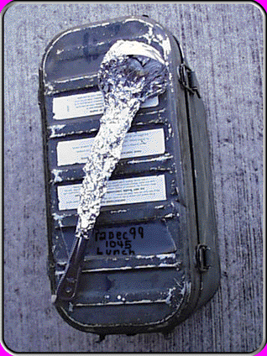
Transporting Utensils
Cover or wrap utensils to prevent contamination.
Can use a clean, sanitized container to store all utensils during and after transport

Slide 39
Serving at the Fundraiser
At least one person at the fundraiser should have taken this course and shall be present at all times
Food handlers should
  Restrain hair
  Sanitize the tables
  Wash hands thoroughly
  Wear gloves or do not handle food with hands

Slide 40
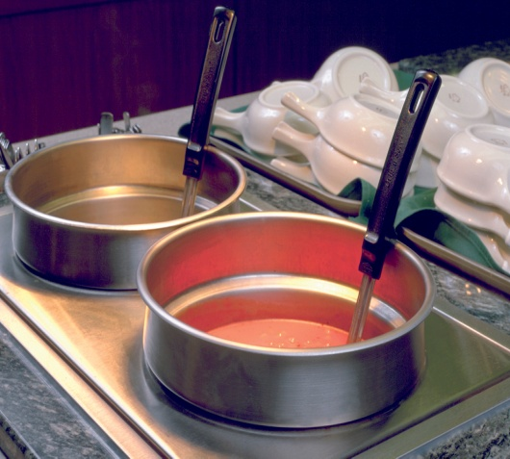
Holding Hot Food
When holding potentially hazardous hot food:
  Hold it at an internal temperature of
  140°F or higher
  Only use equipment that can keep it
  at the proper temperature
  Never use hot-holding equipment
  to reheat food items
  Stir at regular intervals to distribute
  heat evenly
  If you cannot control the temperature, do not serve after 4 hours (including time for transport and preparation)
Notes:
Instructor Notes
Never use hot-holding equipment to reheat food unless it is specifically designed to do it. Most hot-holding equipment is not designed to pass food through the temperature danger zone quickly enough. Food should be properly reheated and then transferred to the holding unit.

Slide 41
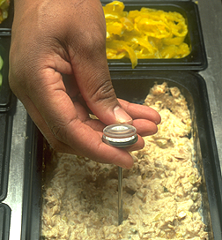
Holding Cold Food
When holding cold food:
  Hold it at an internal temperature of
  40°F or lower
  Make sure you can keep it at that temperature for the duration of your fundraiser (if food will be out longer than 4 hours)
  Do not store unwrapped food directly on ice
  If can’t control temp, don’t serve after 4 hours
Notes:
Never use cold-holding equipment to cool food unless it is specifically designed to do it. Most cold-holding equipment is not designed to pass food through the temperature danger zone quickly enough. Food should be properly cooled and then transferred to the holding unit.

Slide 42
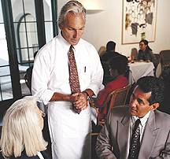
Food Allergens
To protect guests with food allergies:
  Be able to fully describe food ingredients
  If you are unsure if an item is allergen free, urge the patron to buy something else
  Know the common symptoms of an allergic reaction
    Wheezing
    Redness, itchiness
Notes:
You and your staff must be able to fully describe each of your food items when asked. You should be able to tell customers how the item is prepared and identify any “secret” ingredients, if necessary. If you do not know if an item is allergen free, say so.
When preparing food for a customer with allergies, ensure that the food makes no contact with the ingredient to which the customer is allergic. You can also label items with common allergens, such as contains nuts or soy.

Slide 43
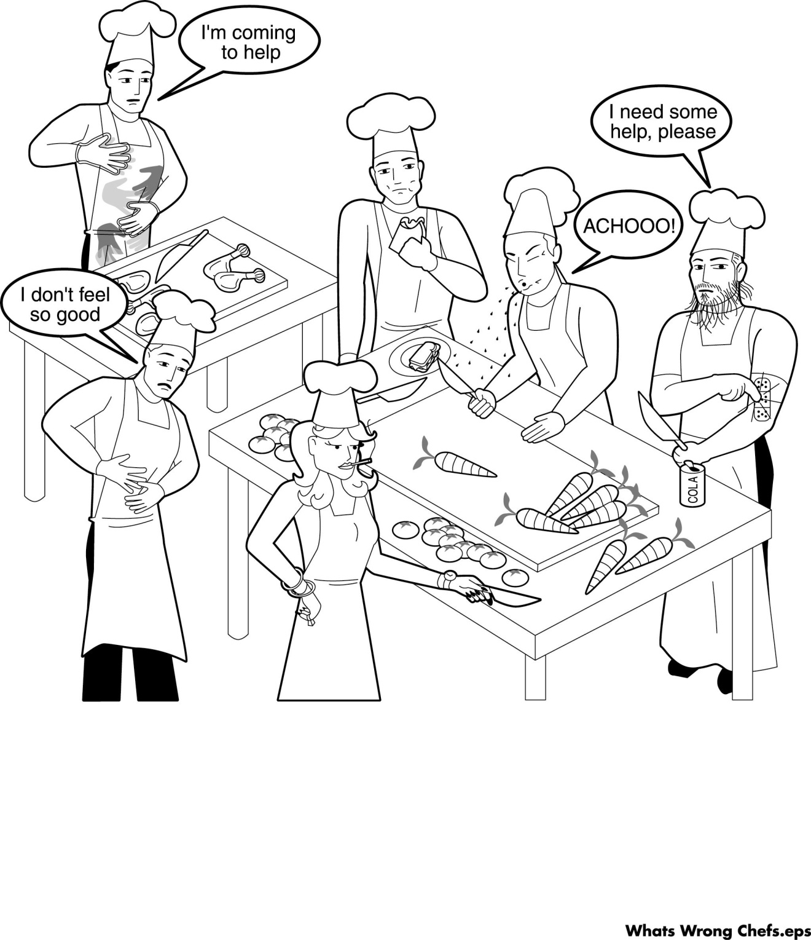
Knowledge Check
What’s wrong with this picture?
Notes:
Think of all the ways these food preparers are potentially contaminating food. (60 seconds of silence for this slide)

Slide 44
Inspection
You can expect to see an Environmental Health Technician at your food fundraiser to ensure compliance of all food safety standards discussed in this course
Please have your training certificates with you at the fundraiser.
If you have not done so already, please contact Environmental Health to register your food fundraiser. (706) 545-6307

Slide 45
Where to get more Information
AR 40-5, Preventive Medicine
Tri-service Food Code, 1 March 2019
Environmental Health Section, Department of Public Health
Point of Contacts (706) 545-3782
  SSG Jennifer Jackson, Jennifer.n.jackson33.mil@health. mil
  CPT Wilbert Paige, Wilbert.i.paige.mil@health.mil
Notes:
For more information on food safety, please reference TB MED 530, Food Service Sanitation. These are the standards Environmental Health uses to ensure food safety on the installation. This can be found digitally online through a search engine. You may also email the contact information on this slide to speak to an Environmental Health Technician. You have now completed the instruction portion of this course. When you advance this slide you will take a multiple choice and true/false exam. You must pass with 80%, or you will have to take this course over from the beginning. Once you have passed the exam, your certificate will be emailed to Environmental Health, and you will be prompted to print your certificate. Please keep this certificate on file, and have with you at any food fundraisers on Fort Benning. This certificate is good for one year. Once the deadline has passed, you must take this course again and recertify in order to have a food fundraiser on Fort Benning.

